Slide 1
Week-7 Journey PPT
Name-Daksh Malik
Batch-1

Slide 2
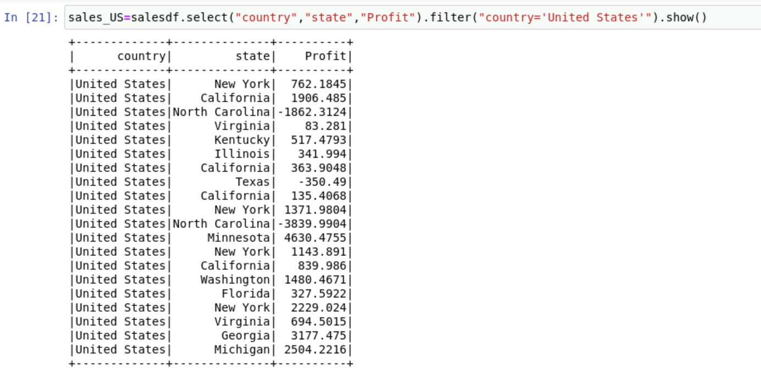
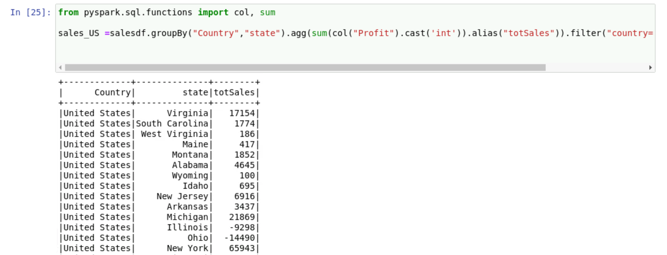
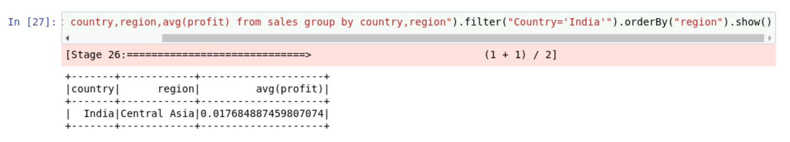
25th September(Monday)
Pyspark commands on aggregate, alias, filter

Slide 3
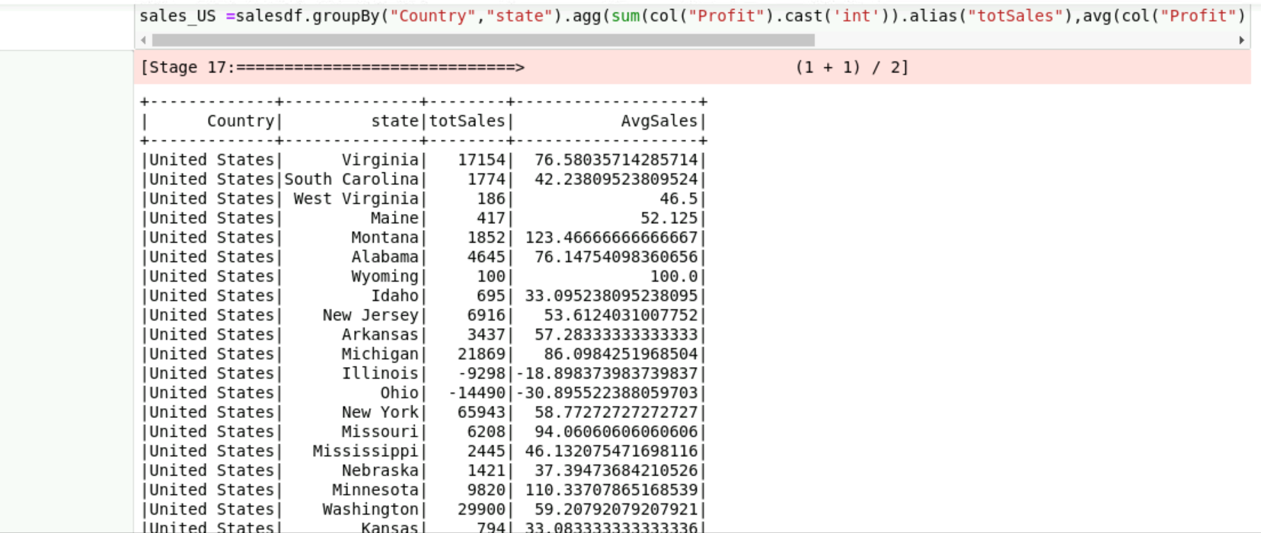
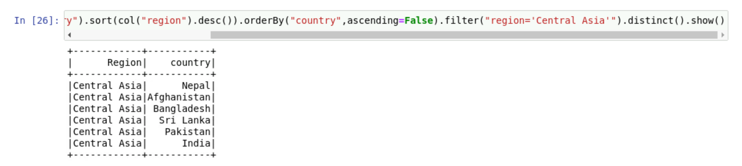
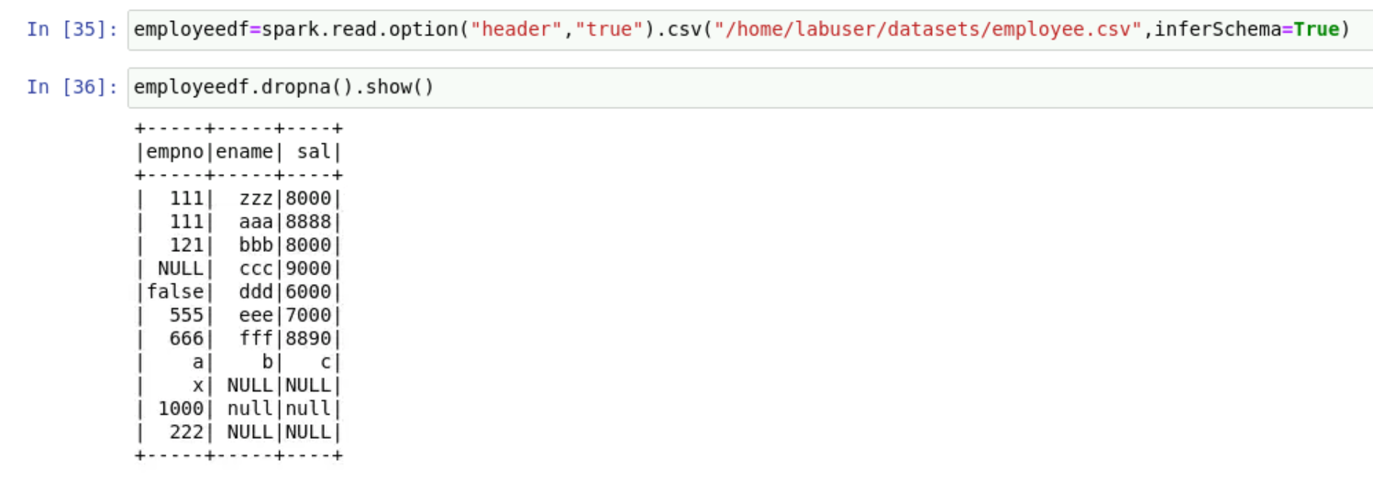

Slide 4
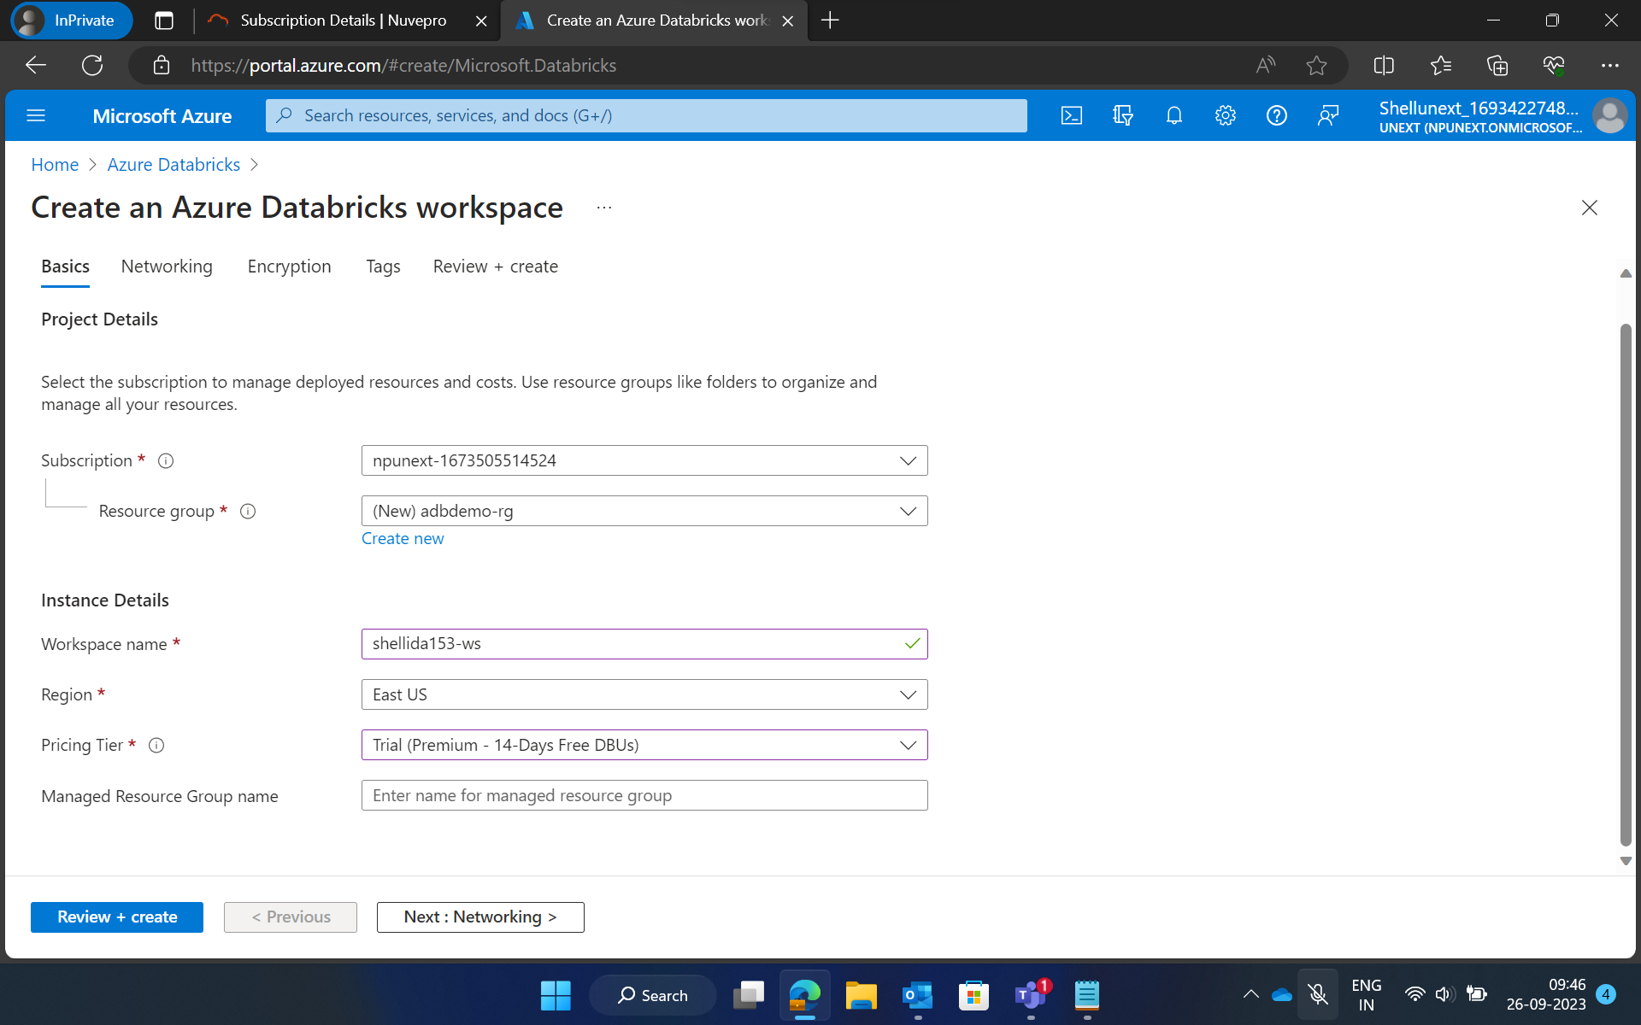
26th September(Tuesday)
Starting with Azure Databricks

Slide 5
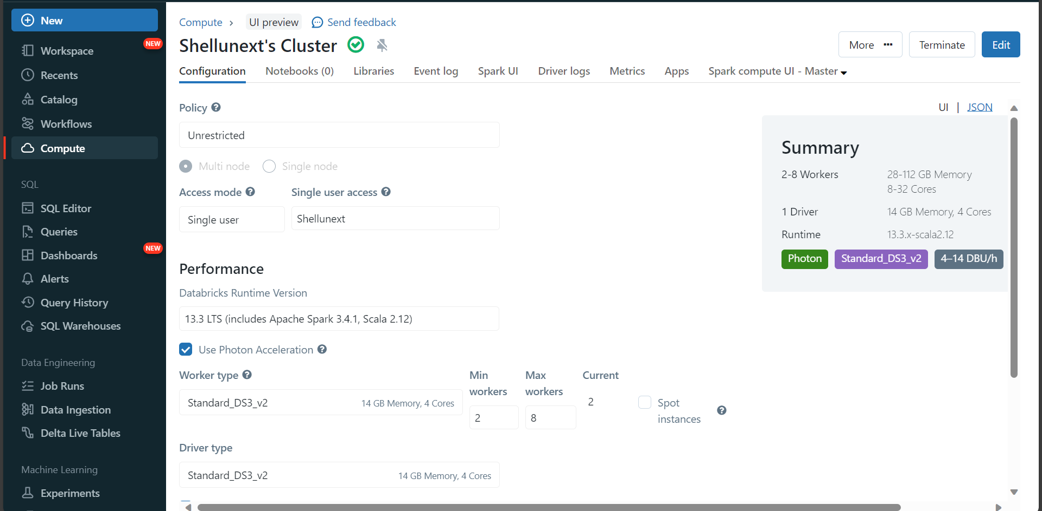
Creating a cluster

Slide 6
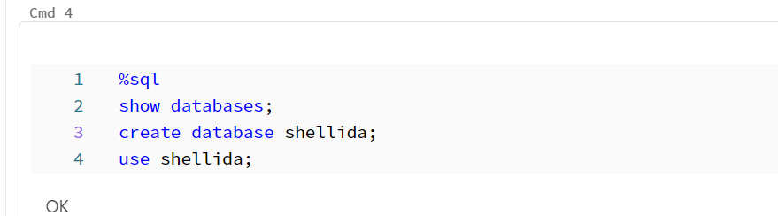
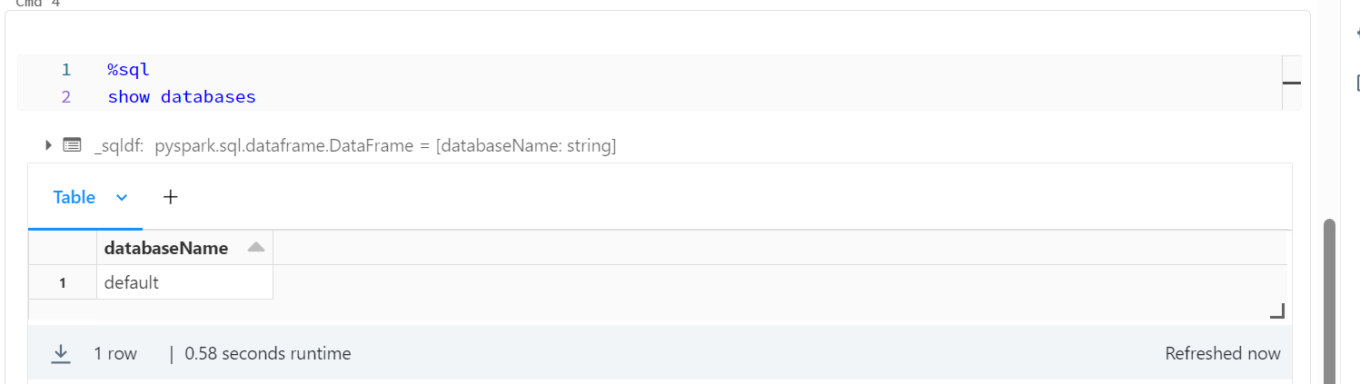
Creating a database

Slide 7
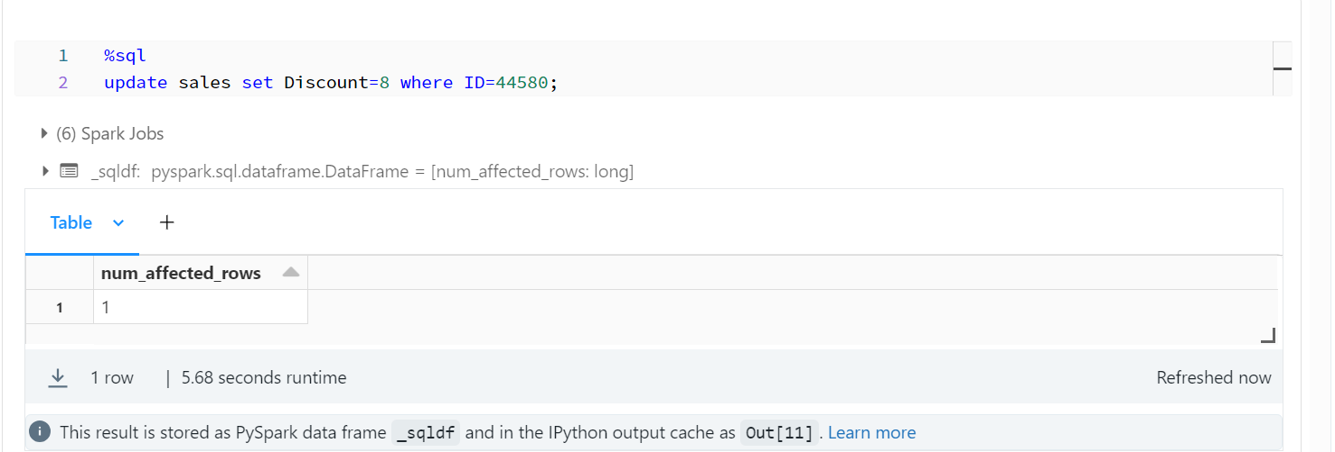
Updating Sales table

Slide 8
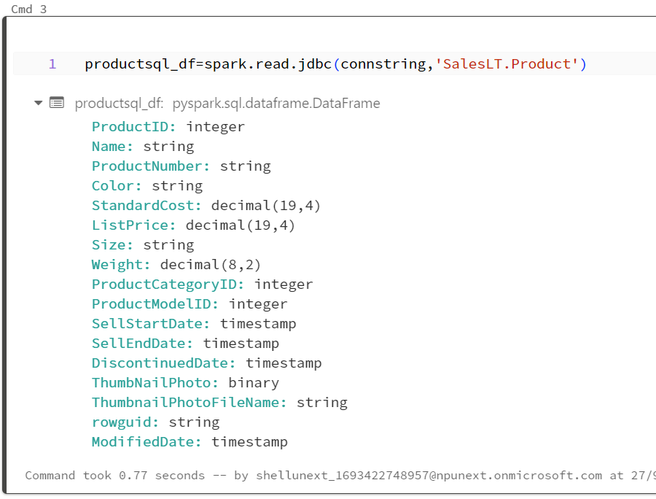
27th September(Wednesday)
Establishing JDBC connection

Slide 9
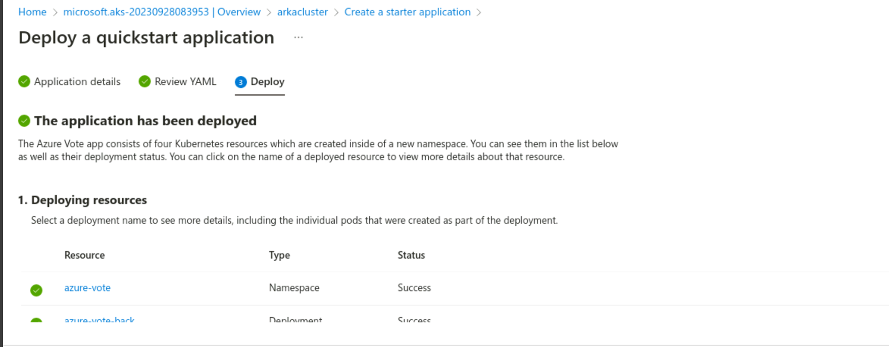
Deployment of Quickstart application

Slide 10
Thank You

